Slide 1






ARTIFICIAL INTELLIGENCE
DEEPFAKE
DETECION

Slide 2

ABTSRACT
As the prevalence of deepfake videos continues to escalate, there is an urgent need for robust and efficient detection methods to mitigate the potential consequences of misinformation and manipulation. This abstract explores the application of Long Short-Term Memory (LSTM) networks in the realm of deepfake video detection.
The proposed methodology involves preprocessing of video data, including the creation of high-quality training datasets and the application of data augmentation techniques to enhance model generalization. The training process and optimization strategies specific to LSTM networks are explored to achieve optimal performance in deepfake detection.

Slide 3


DEEPFAKE VIDEOS
INTRODUCTION
Deepfakes, generated by sophisticated artificial intelligence algorithms, have the ability to seamlessly replace faces and manipulate audio, blurring the lines between truth and fiction. As the technology behind deepfakes advances at an unprecedented pace, the implications for misinformation, identity theft, and malicious content creation become increasingly profound.

Slide 4

EXISTING SYSTEM
CNN, known for its residual learning framework, excels in training deep neural networks. Its ability to extract features and learn hierarchical representations makes it a compelling choice for deepfake detection.
An exploration of the ResNet architecture, emphasizing its unique approach to handling deep networks and effectively capturing nuanced features crucial for identifying manipulated content.

Slide 5




DISADVANTAGES
Limited Temporal Understanding:
CNN primarily focuses on spatial features in images and lacks built-in mechanisms for capturing temporal dependencies in video data. Deepfake detection often requires understanding the temporal context, which CNN may not handle optimally.
01
Large Computational Requirements:
CNN architectures are deep and can be computationally expensive, especially when dealing with high-resolution video frames. This can pose challenges in real-time deepfake detection or applications with limited computational resources.
02

Slide 6
DISADVANTAGES
Vulnerability to Adversarial Attacks:
CNN architectures, like many deep learning models, are susceptible to adversarial attacks. Adversarial examples specifically crafted to deceive the model could potentially lead to false negatives in deepfake detection.
03
Training Data Imbalances:
If the training data is not balanced, with an overrepresentation of certain types of deepfakes, CNN may be biased towards detecting those specific variations and may struggle with novel or less frequent types of manipulations.
04

Slide 7



PROPOSED SYSTEM

Slide 8


PROPOSED SYSTEM
Deepfake videos, fueled by artificial intelligence, pose a significant challenge to the authenticity of visual content. This presentation explores the application of Long Short-Term Memory (LSTM) networks in the realm of deepfake detection, leveraging their sequential learning capabilities to unravel the complexities of manipulated videos.
Deepfakes, the product of advanced AI algorithms, manipulate faces and audio to create convincing yet entirely fictitious content. The need for robust detection methods has never been more crucial as deepfake incidents continue to escalate.

Slide 9
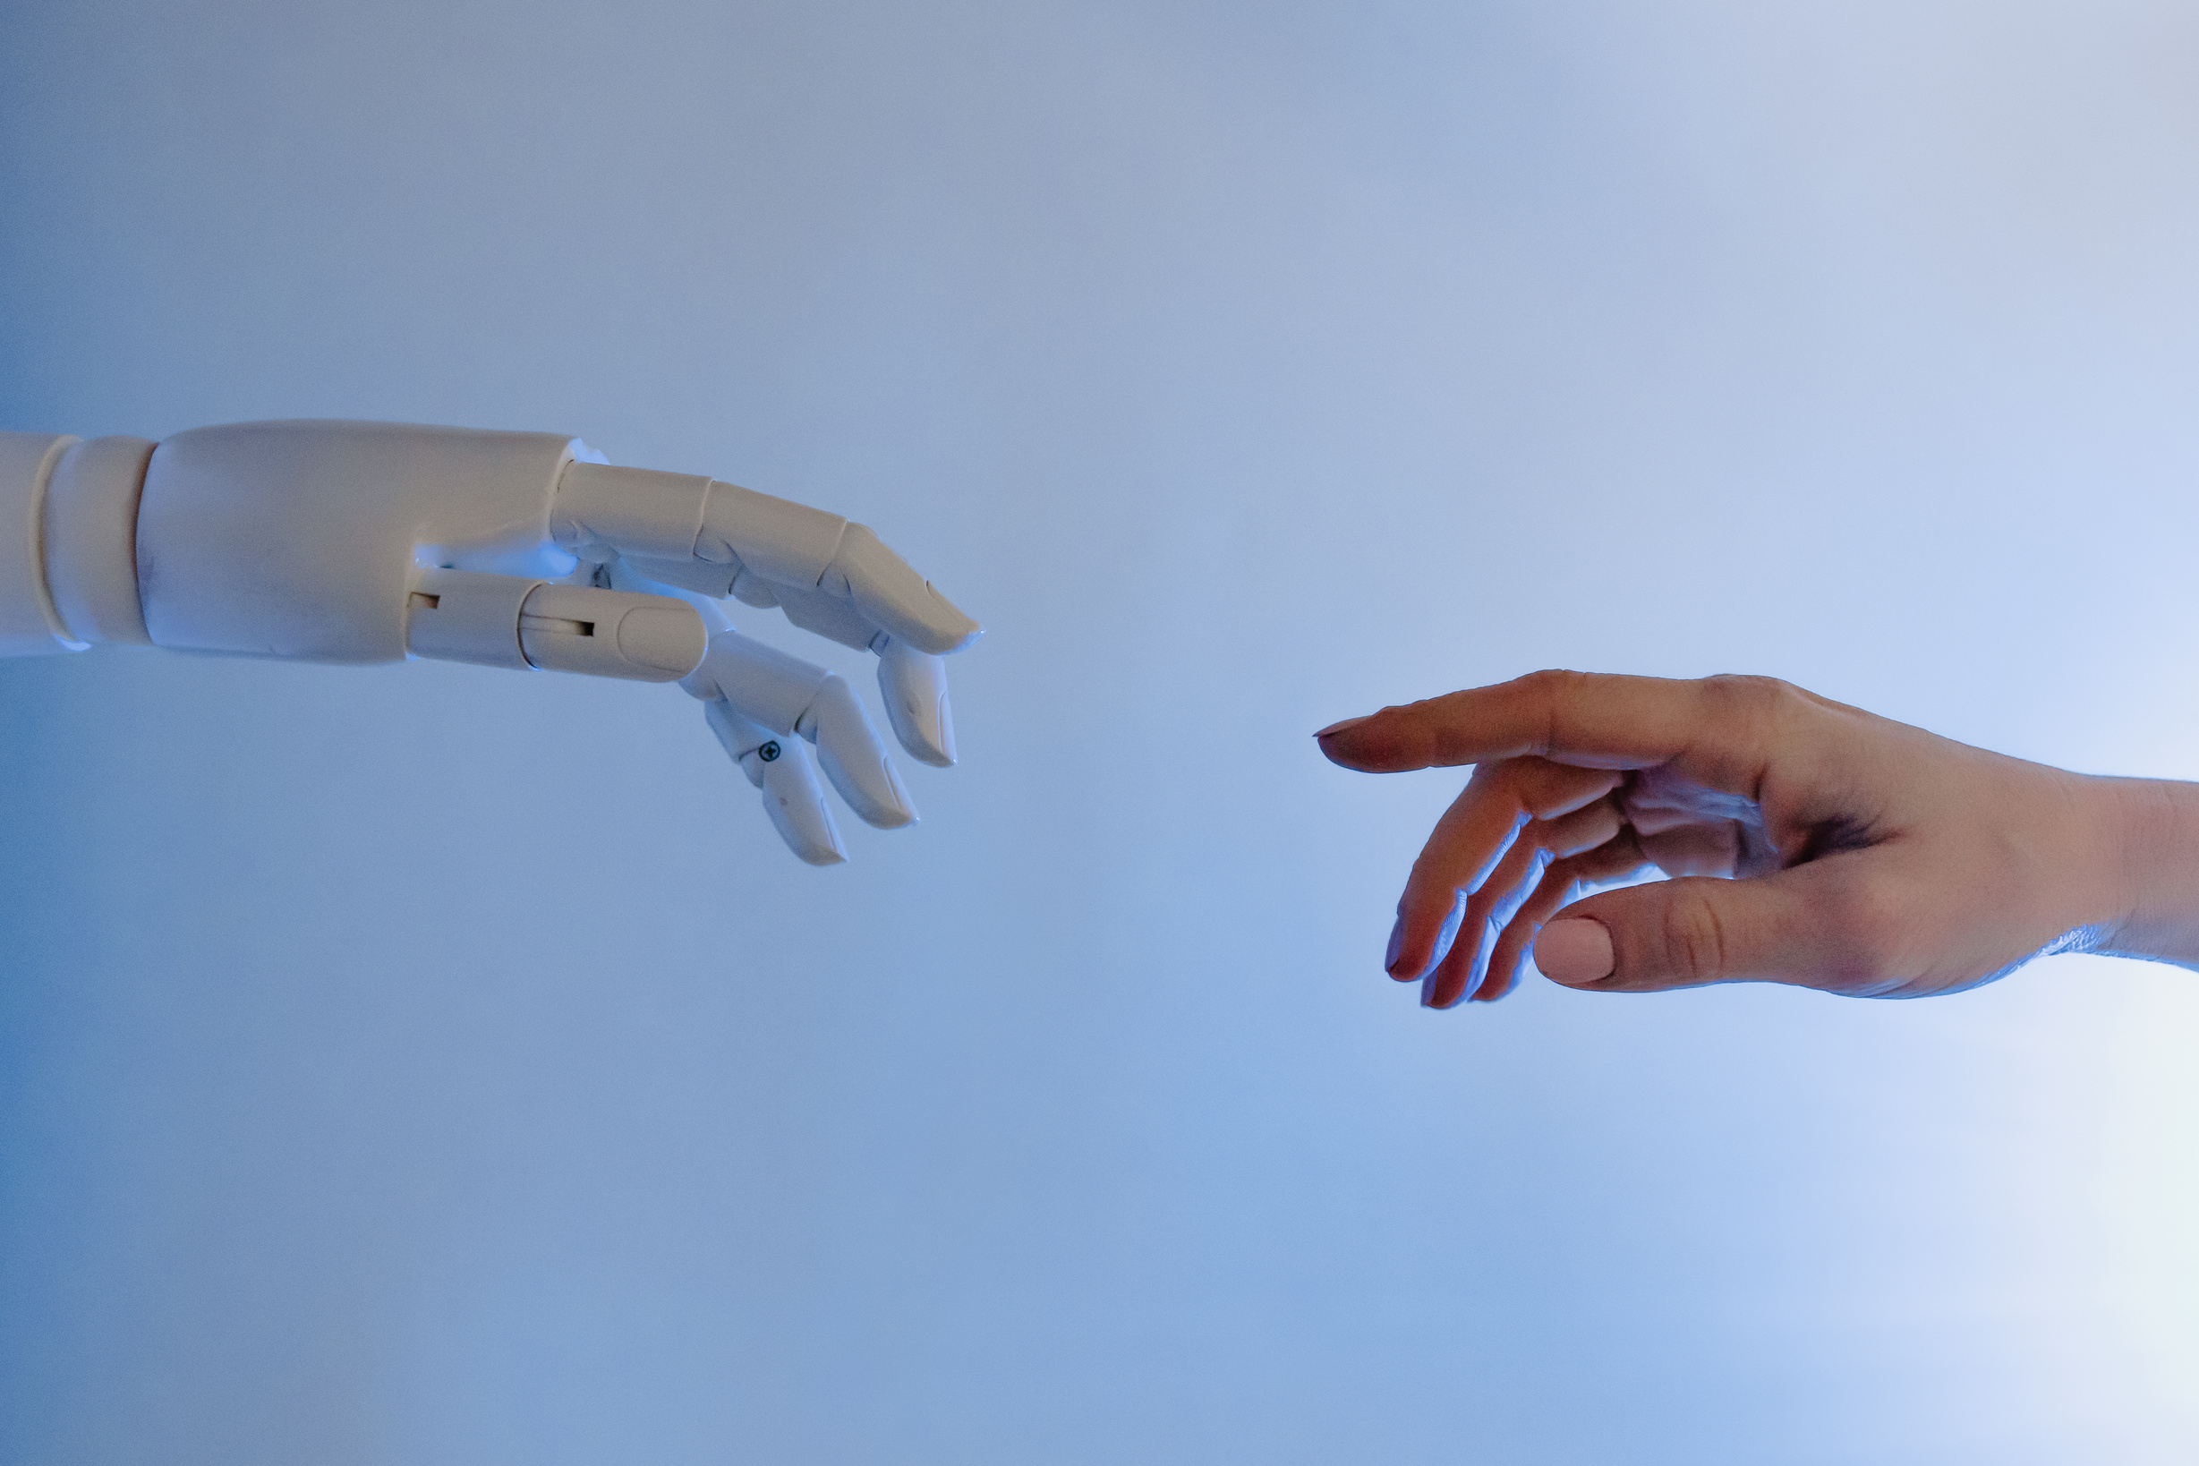
PROPOSED SYSTEM
LSTM, a type of recurrent neural network (RNN), excels in capturing long-range dependencies and sequential patterns. This makes it well-suited for the temporal intricacies present in video data, a key requirement for effective deepfake detection.
n in-depth exploration of LSTM architecture, highlighting its ability to retain memory and learn from sequential information. Understanding how LSTM processes video data to discern patterns indicative of deepfake manipulation.

Slide 10
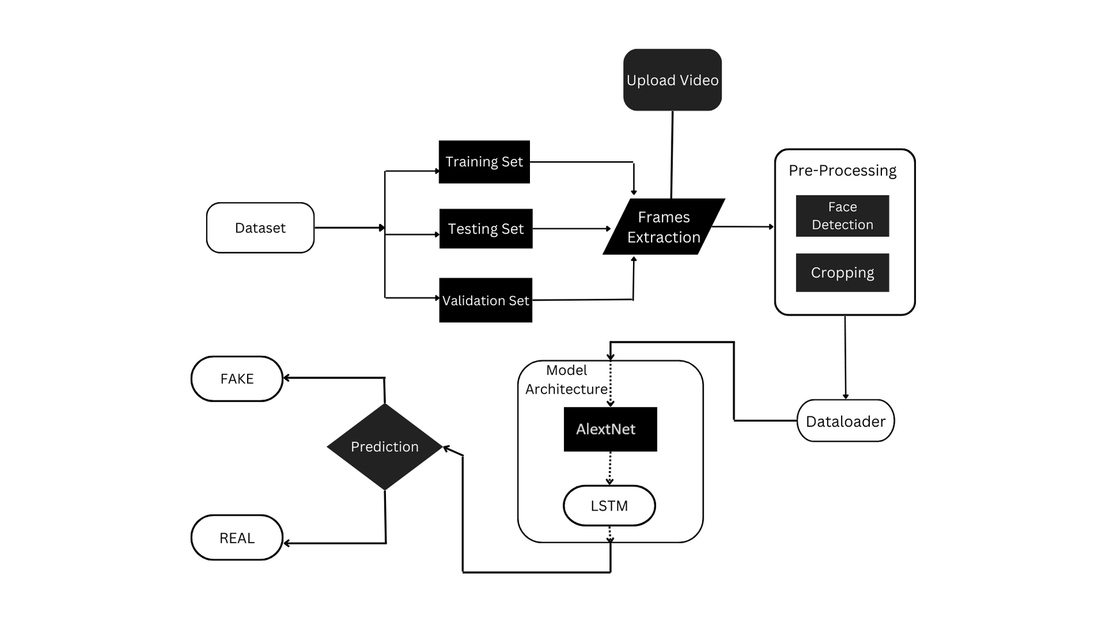
ARCHITECTURE

Slide 11





MODULES
MODULE 1
MODULE 2
MODULE 3
MODULE 4
Daatset Collection:
Collect deepfake videos created using different techniques, including face swapping, lip syncing, and voice manipulation. This ensures the model is exposed to a variety of manipulation methods.
Data Preprocessing:
Emphasis on the significance of high-quality training data, and the role of data preprocessing techniques to ensure the LSTM model is trained on a diverse and representative dataset.
Training the LSTM Model: Insights into the process of splitting data into training and validation sets, along with the training process, optimization strategies, and fine-tuning specific to LSTM networks.
Evaluation Metrics: Introduction to key evaluation metrics, such as accuracy, precision, recall, and F1 score, tailored for assessing the efficacy of LSTM-based deepfake detection.

Slide 12
HARDWARE/SOFTWARE REQUIREMENT
HARDWARE REQUIREMENTS:
System : Pentium i3 Processor.
Hard Disk : 500 GB.
Monitor : 15’’ LED
Input Devices : Keyboard, Mouse
Ram : 4 GB
SOFTWARE REQUIREMENTS:
Operating system : Windows 10 Pro.
Coding Language : Python 3.10.9, HTML, CSS,JS
Web Framework : Flask

Slide 13






ADVANTAGES
INCREASED EFFICIENCY
The dynamic and evolving nature of deepfake technology presents challenges for traditional detection methods. LSTM emerges as a promising solution, capable of capturing temporal dependencies crucial for understanding the context of video data.
HANDLING FRAME RATES
Videos may have varying frame rates, and LSTMs are capable of handling irregular temporal sampling. This flexibility is beneficial for deepfake detection as it accommodates the natural variability in video data.
ENHANCED ACCURACY
LSTMs are inherently robust to noise and occlusions in the data. In real-world scenarios, videos may contain noise or occluded faces, and LSTMs can learn to distinguish between genuine variations and manipulated content.

Slide 14

CONCLUSION
In conclusion, the application of Long Short-Term Memory (LSTM) networks in deepfake detection represents a significant stride forward in combating the ever-growing threat of manipulated videos. The unique strengths of LSTMs, including their sequential learning capabilities and memory retention, make them a compelling choice for discerning temporal patterns crucial in identifying deepfake content.
LSTMs excel in capturing complex temporal dynamics, handling varying frame rates, and adapting to sequences of different lengths. This adaptability is crucial in real-world scenarios where deepfake videos exhibit diverse and sophisticated manipulation techniques.

Slide 15
REFERENCE
[1] Zhiqing Guo, Gaobo Yang, Jiyou Chen, Xingming Sun (2021) “Fake face detection via adaptive manipulation traces extraction network” in Computer Vision and Image Understanding-Volume 204.
[2] Belhassen Bayar and Matthew C. Stamm (2016) “A Deep Learning Approach to Universal Image Manipulation Detection Using a New Convolutional Layer” in IH & MM Sec '16: Proceedings of the 4th ACM Workshop on Information Hiding and Multimedia Security.
[3] Richard Zhang et al., (2018), “Making Convolutional Neural Networks Shift-Invariant Again” in ICML 2019.
[4] Sheng-Yu Wang, Oliver Wang, Richard Zhang, Andrew Owens, and Alexei A Efros. CNN-generated images are surprisingly easy to spot...for now. In IEEE Conference on Computer Vision and Pattern Recognition, 2020.
[5] Carlini, N. and Farid, H. (2020) “Evading deep-fake-image detectors with white-and black-box attacks” in IEEE Conference on Computer Vision and Pattern Recognition (CVPR) Workshops.

Slide 16





RESOURCES

Slide 17
THANK YOU!

